Slide 1
Research Method

Slide 2




General Types of Data Granularity
Each information collection method drives a particular result
Data mining
Surveys
Focus Groups
In-depth Interviews
Quantitative
Broad identification of what, via patterns and trends.
Good for informing where to start, confirming, and refuting hypotheses.
Qualitative
Deep understanding of why, via problem, values and needs.
Good for inspiring new solutions and identifying opportunities.
Notes:
Each method of collecting information drives a particular result. What types of methods might best answer your research questions?
Data mining: subfield of computer science - discovering patterns in large data sets.
Focus groups: expensive, need a professional facilitator. E.g. Election season
Making the case for in-depth interviews:
People are difficult to understand. Our knowledge of users is limited. Responses to surveys and focus group questions can be incomplete or inaccurate, not least because people may not feel comfortable disclosing certain information to others. Whether motivated by a desire to please the people asking the questions, or the perception that it is actually what they would do!
WHY interview? You want to understand a person’s thoughts, emotions, and motivations, so that you can determine how to innovate for him or her. By understanding the choices that person makes and the behaviors that person engages in, you can identify their needs, and design to meet those needs.
Interviewing is how we, as designers, see the world through other people’s eyes and get them to tell us their stories.
Who they are, what the meaning of certain things are (not in survey)
We list some collection methods here, but depending on the problem, they may go in different orders.
https://unsplash.com/photos/Wpnoqo2plFA
https://unsplash.com/photos/Lks7vei-eAg

Slide 3
Interviews

Slide 4



Interview Formats
 | Unstructured Interview | Semi-Structured Interview | Structured Interview
Interview Formats
Notes:
At this point you should start by understanding the context, it includes visiting places related to your project and talking to people who know about the issue you want to address.
When conducting these intercept interviews remember to describe who you are (i.e., student from UIU), tell them it’s a homework, have prepared 2-3 questions in advance, and have a notepad in hand. It should feel like a friendly talk with a stranger.
When observing a place remember to take pictures of the entrance, bulletin board, etc.
After each interview take a few minutes with your partner (if go in pair) and reflect on that: What did you hear/see? What did you learn? Keep a record of what you’ve learned.
Image source: Bellomy (2020). In-Store Intercept Surveys. Retrieved from: https://bit.ly/38SSnp4

Slide 5
Interview Formats
3 general interview types
 | Unstructured Interview | Semi-Structured Interview | Structured Interview
 | little knowledge about the interview topic no guide and exploratory in nature due to high flexibility, off the cuff go with the flow, the interview becomes the apprentice / learner | some knowledge about the interview topic a less strictly defined guide with themes and questions you want to learn about deviations are allowed and encouraged → probing but staying on topic | lots of knowledge about the interview topic strictly defined list of interview questions no deviations are allowed from topic or questions across interviews or participants
Interview Formats
Notes:
At this point you should start by understanding the context, it includes visiting places related to your project and talking to people who know about the issue you want to address.
When conducting these intercept interviews remember to describe who you are (i.e., student from IU), tell them it’s a homework, have prepared 2-3 questions in advance, and have a notepad in hand. It should feel like a friendly talk with a stranger.
When observing a place remember to take pictures of the entrance, bulletin board, etc.
After each interview take a few minutes with your partner (if go in pair) and reflect on that: What did you hear/see? What did you learn? Keep a record of what you’ve learned.
Image source: Bellomy (2020). In-Store Intercept Surveys. Retrieved from: https://bit.ly/38SSnp4

Slide 6
Interview Formats
3 general Interview types
 | Unstructured Interview | Semi-Structured Interview | Structured Interview
 | little knowledge about the interview topic no guide and exploratory in nature due to high flexibility, off the cuff go with the flow, the interview becomes the apprentice / learner | some knowledge about the interview topic a less strictly defined guide with themes and questions you want to learn about deviations are allowed and encouraged → probing but staying on topic | lots of knowledge about the interview topic strictly defined list of interview questions no deviations are allowed from topic or questions across interviews or participants
Interview Formats

Slide 7
Question Formats
 | Closed Questions | Open-ended Questions
Question Formats

Slide 8
Question Formats
 | Closed Questions | Open-ended Questions
 | easy to analyze & easy to scale → provide the how little insight and data (yes/no) → lean toward quantitative data (surveys) ideal for situations where a quick decision is needed | difficult to analyze & hard to scale → provide the why lots of insight and detail → lean toward qualitative data (in-depth interviews) ideal for situations where deeper understanding is required
Question Formats

Slide 9
Question Formats
 | Closed Questions | Open-ended Questions
 | easy to analyze & easy to scale → provide the how little insight and data (yes/no) → lean toward quantitative data (surveys) ideal for situations where a quick decision is needed | difficult to analyze & hard to scale → provide the why lots of insight and detail → lean toward qualitative data (in-depth interviews) ideal for situations where deeper understanding is required
Question Formats

Slide 10

Let’s look at an interview
What do you think about this interview?
What did you like?
What could be better?
http://www.youtube.com/watch?v=U4UKwd0KExc

Slide 11



Slide 12

Interview Stages | Preparation
1. Research your study participant
You have to come in with lots of knowledge about the person and the topic.
2. Prepare a set of themes to explore, draft an interview protocol
Determine the order that would allow the conversation to flow most naturally.
3. Be participant-centered
Ask what day, time, and location works for the individual you would like to interview.
4. Be early, be prepared
Make sure you know where you are going and be 10 minutes early. You want to make a good impression.
5. Define roles beforehand
Ideally two team members participate in the session: one leads the interview (ask questions), while the other takes notes and photographs (if appropriate). Ask for permission to audio record the interview.
A space mission analogy:
Lots of effort and time is invested launch preparation.
Notes:
From the reading – creating questions:
Identification of the domain
Leadoff Question
Covert Categories
Follow-up Questions
Magic Words
You have to come in with lots of knowledge, about the person, about the topic. Interviewees only have so much time so use it wisely. Don’t waste it by finding out information was available elsewhere; you want to get beyond information that’s publicly available.
WHY prepare for an interview
Time with users is precious; you need to make the most of it! While you must always allow room for the spontaneous conversation. it is imperative to plan your interviews. You may not get to every question you prepare, but you should come in with a plan for engagement.
Take a few moments to make sure that you leave room in your planning to ask plenty of “why?” questions, plenty of “tell me about the last time you …?” questions, and plenty of questions that are directed at how the user feels.
The interviews should happen in the context of the target activity
Ask them where they want to be interviewed, look around and decide what to ask to proceed the discussion, powerful way to tell stories, tell me about this picture,
Context helps explain the inconsistencies between what people think, say, and do
“If you want to understand how a lion hunts, don’t go to the zoo. Go to the jungle.” -FRANK CHIMERO
Make sure you’re prepared to capture. If you’re not interviewing in pairs, you should use a voice recorder (ask for permission)—it is impossible to properly engage a user and take detailed notes at the same time.
Prevent intimidating environment! (as the interviewer, YOU are in the position of power). Make them feel comfortable
https://unsplash.com/photos/9dF7pCyaM9s

Slide 13

Interview Stages | Execution
1. Introduce the project and yourselves
A good interview is a friendly conversation. Briefly describe your research and the goals of the interview.
2. Dig for stories, feelings, and emotion
Even when you think you know the answer, ask people why they do or say things. Ask open-ended questions, and continually ask the participant to provide concrete examples. Try not to say usually when asking a question. Instead, ask about a specific instance or occurrence.
3. Notice inconsistencies but don’t correct them
Sometimes what people say and what they do are different.
4. Pay attention to nonverbal cues
Take notes of what they say and what they don’t say. Be aware of body language and emotions.
A space mission analogy:
Between launch and landing,
very limited time is available to execute
the mission and reach the goal.
Notes:
Do not rush into the questions, care about the topic and the participant.
Introduce yourself, share something about yourself, but make sure to move the focus to the participant. Watch for their body language to relax before you move on.
Be charming, positive, and reassuring. Be genuinely interested in what they are saying.
A good warm up question: tell me about the first time you did something that you loved
Whether or not the stories people tell are true, they reveal how they think about the world. Ask questions that get people telling stories. If not naturally storyteller: tell me the story of your last time …, can you tell me what happened. Encourage storytelling by often asking ‘why’ or saying ‘tell me more’
Help them be specific. Do not ask “what is your average day” instead ask “what happened the last time…”
Follow up by asking:
Can you tell me about?
Say more…
Why?
Wrapping up
Look for any conflict or inconsistency (based on your notes), and ask for explanation.
Go back to any points of conflict or inconsistency (based on your notes), probe for resolution or explanation.
Ask follow up questions on any topic that requires more detail or information.
Ask for follow up interview if necessary
Share your finding with them: tell them you will get back in touch toward the end of the semester
https://unsplash.com/photos/NVWyN8GamCk

Slide 14
Interview Stages | Execution Common mistakes! [Don’t do these]
Avoid compound questions. E.g. How often do you check Snapchat and what is the reason? Also, tell me how do you gather information and who do you ask for help?
Avoid leading/directive questions/ binary questions. These questions may imply that there is a right answer or lead respondents to answer in a particular way. E.g. Besides this website, what are other trusted sources? Friends?
Don’t fall into trap of leading expressions. E.g. nodding, saying aha, that’s great, interesting, yeah, I see, etc. Yet you have to balance with not being deadpan.
Don’t suggest answers to your questions. Even if they pause before answering, don’t help them by suggesting an answer.
Don’t be afraid of silence. Allow for silence, they may reflect on what was just said and reveal something deeper.
A space mission analogy:
Between launch and landing,
very limited time is available to execute
the mission and reach the goal.
Notes:
When people first start interviewing, they fall into certain trap of leading interviewees by nodding, saying aha, that’s great, interesting, yeah, I see, thanks.
Don’t let the information that they get surprises you too much. Never too surprised or too bored. Look interested.
Don’t suggest answers to your questions. This can unintentionally get people to say things that agree with your expectations.

Slide 15

Let’s look at an interview … again
How to do an Interview
What was different in this interview in comparison to the first interview you saw?
http://www.youtube.com/watch?v=eNMTJTnrTQQ

Slide 16
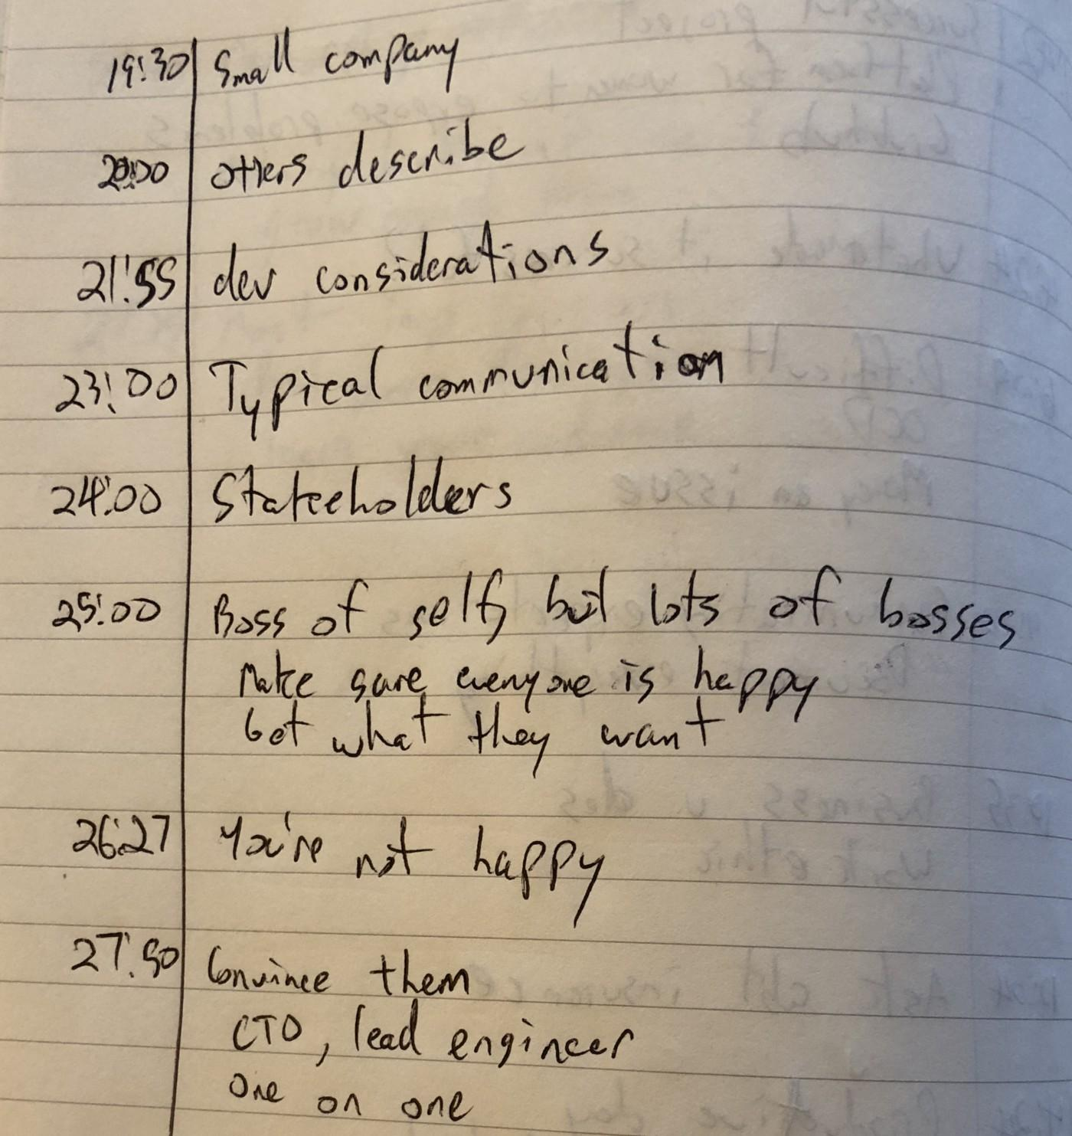
Interview Stages | Execution
Take notes!
Use time stamps (especially helpful if recording)
It is okay if they only make sense to you, but they must make sense!
They may not make sense tomorrow or next week
From “Developing interview questions for in-depth responses” by A. Hunsucker

Slide 17

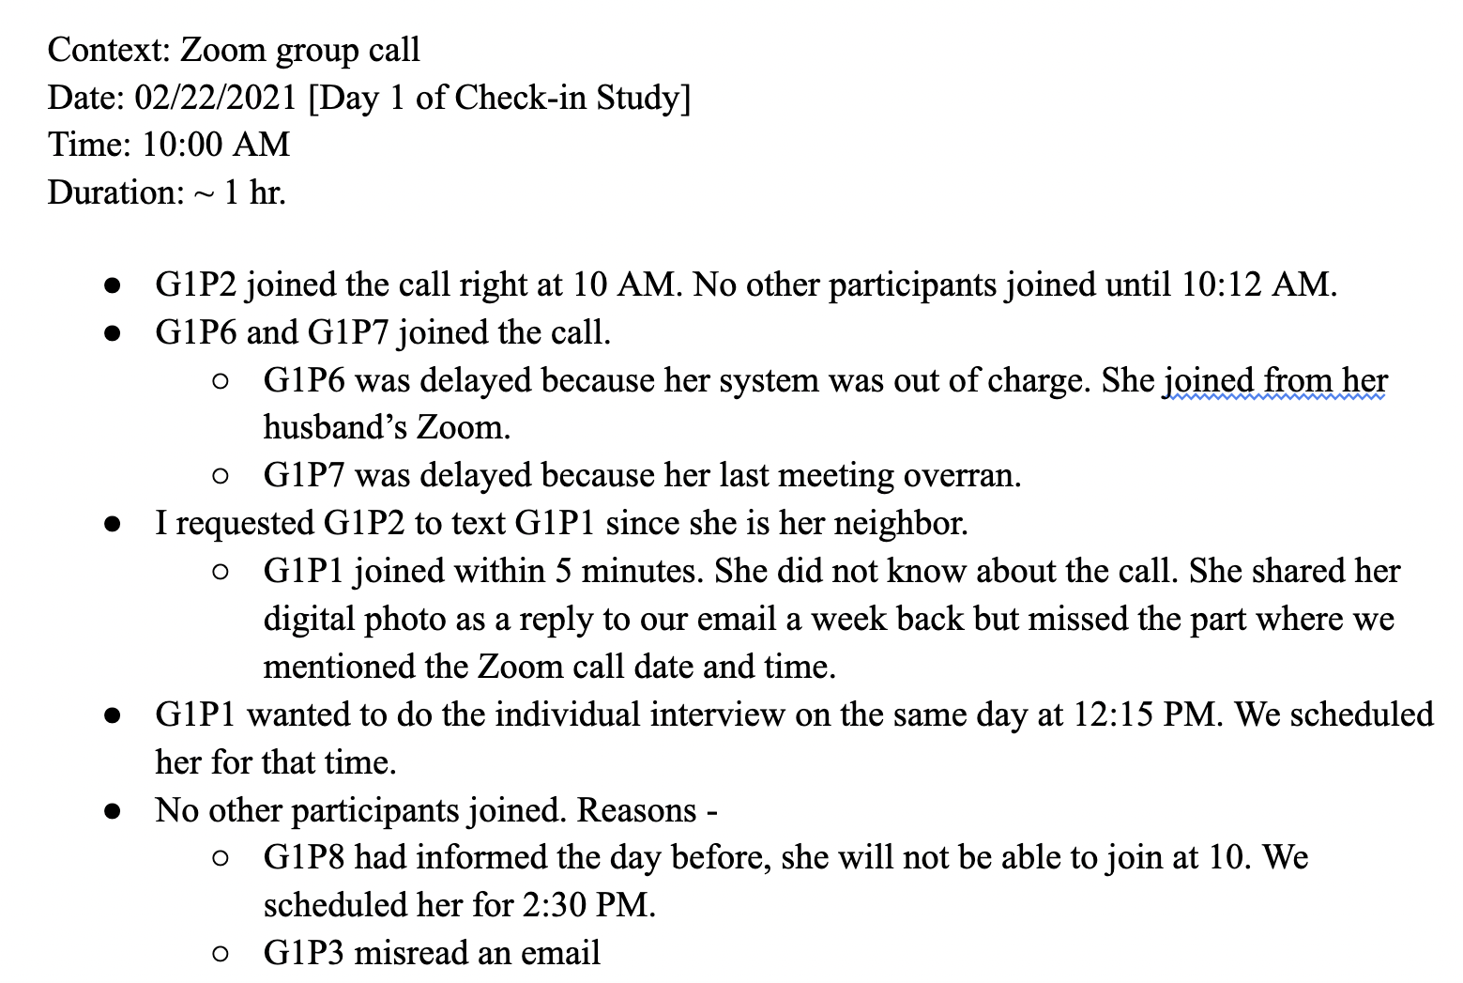
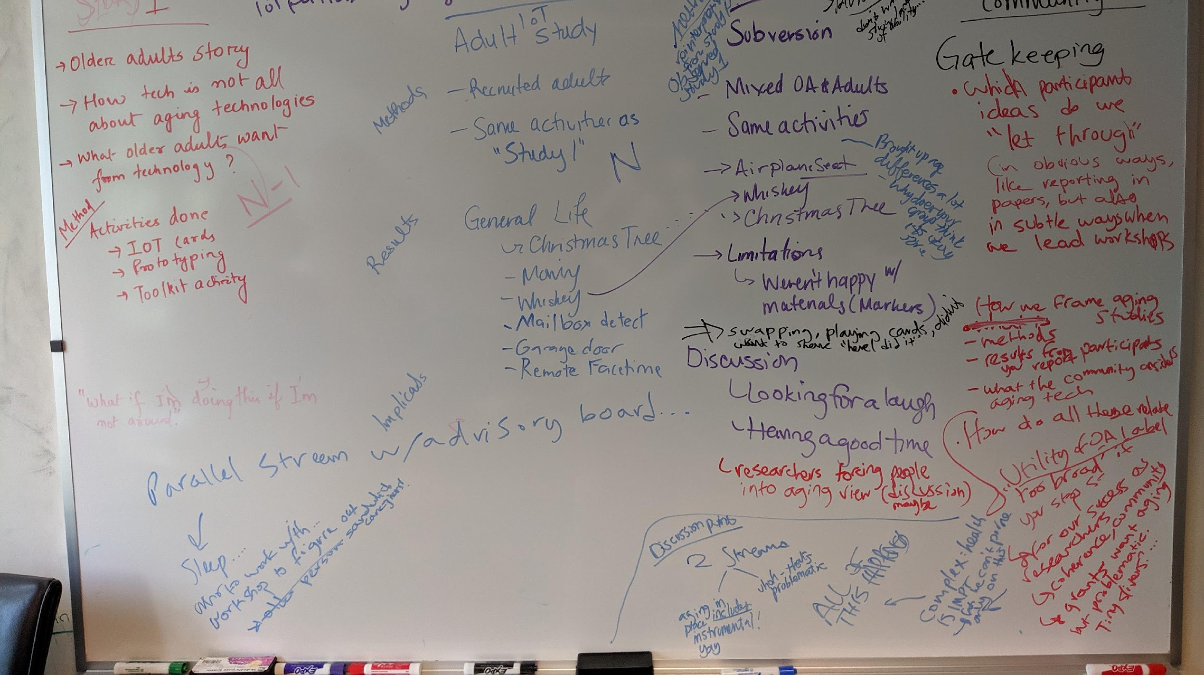
Interview Stages | Post (3/3)
Ideally the same day…
… create a summary (aka braindump) using your interview notes, debrief notes, recordings, and experience.
… debrief with your Team and share the summary and 2-3 most important insights gathered.
Notes:
Here is an example whiteboard from a debrief session. It is a time to brain dump everything you saw, heard, and thought about during the session.

Slide 18
In-class Activity

Slide 19
In-class activity
Sit with your group
Bring out the problem statement
Decide on what you want to explore or understand through the research method
What should be research questions?
Decide on which research methods to apply
Decide on who is your potential participants and how you plan to reach out to them
Finalize your research method
How long do you need to collect data?
Where do you plan to store the collected data?

Slide 20
Homework

Slide 21
Tasks
Go back to the Miro board
Update/refine/modify your problem statement
Add the following information
Who are the target user group?
How you plan to reach out to that group?
Which research methods you plan to adopt?
Prepare data collection instruments
Interview guide
Survey

